Slide 1
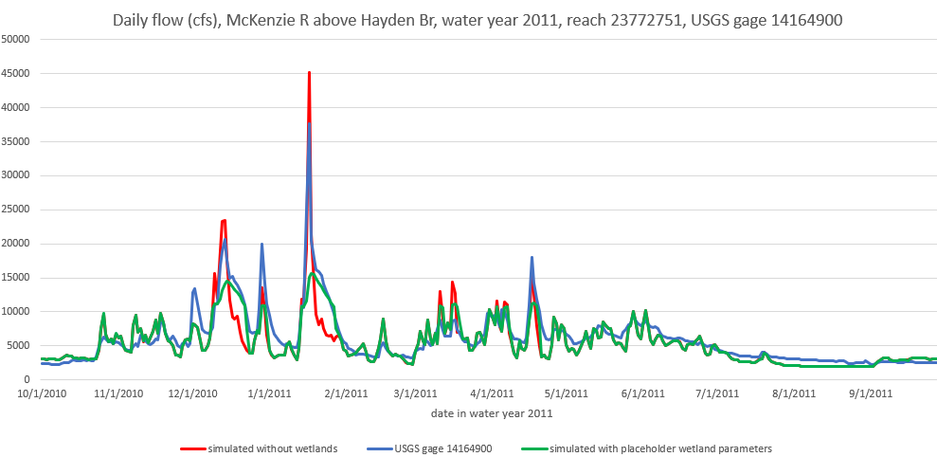
CW3M 1.2.1 wetland model example
Red line is flow simulated without wetlands
Green line is flow simulated with placeholder wetland parameters
Blue line is gage measurements
Note high peak flows simulated when the wetlands are left out (red line).
Note reduced peak flows and longer recession curves when placeholder wetlands are included (green line).
Outside of high flow times, the green line matches and hides the red line.
Note the relationship of the gage readings (blue line) to the simulated values with and without wetlands during peak
flows and the recessions after the peaks.

